Slide 1
Fall
Design
Presentation
Logan Castonguay

Slide 2
Purpose and Goals
Purpose - To create a tower defense-style game based on UC.
Goals - Showing a functional game at the 2026 CEAS Expo, publishing a functional game with a working leaderboard, learning more about C#, Unity, and game development.

Slide 3
Team Members
Logan Castonguay
Computer Science
castonln@mail.uc.edu

Slide 4
Project Advisor
Hrishikesh Vinayak Bhide
bhidehk@ucmail.uc.edu

Slide 5
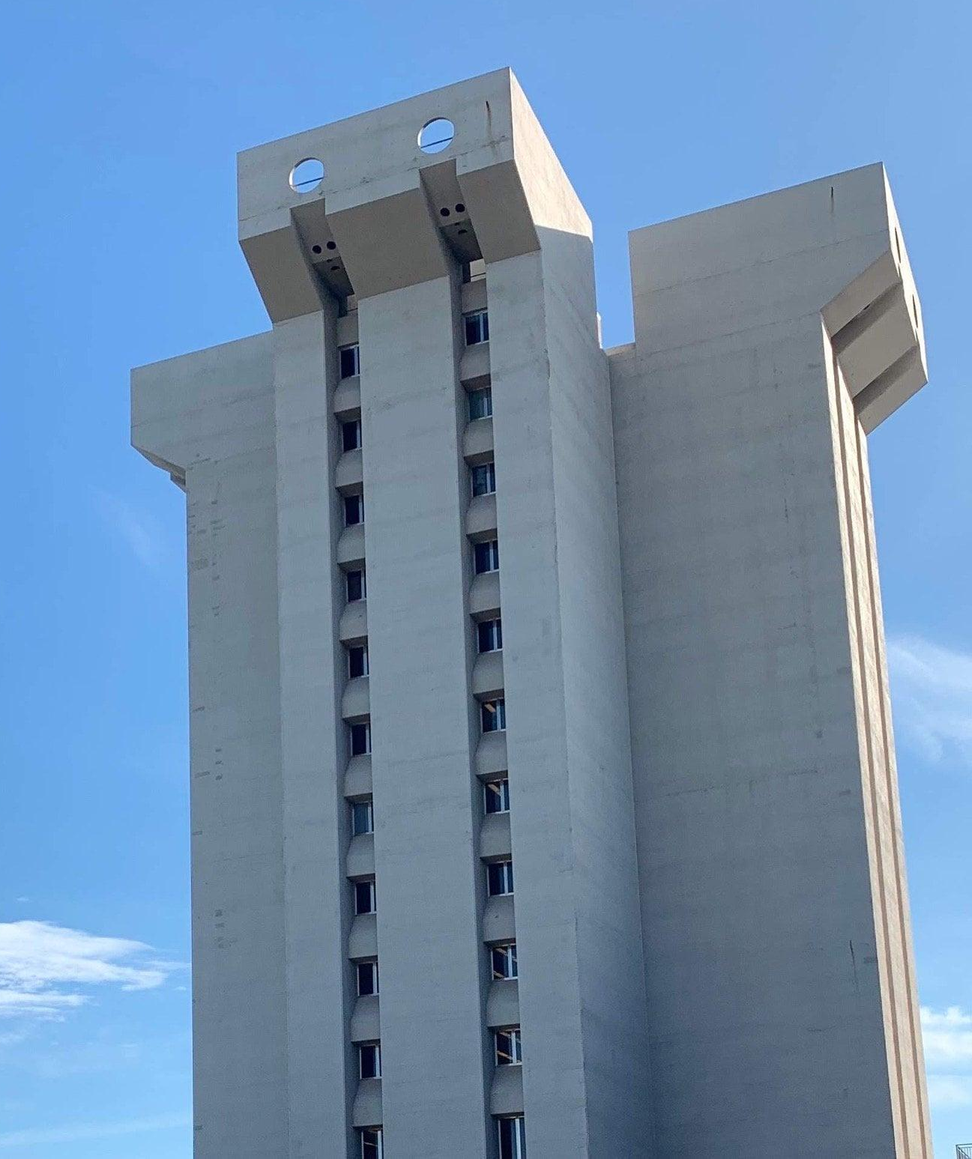
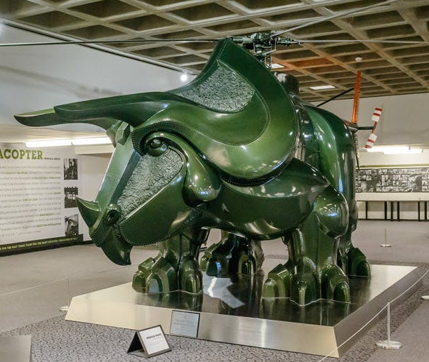
Abstract
Crosley Tower Defense is a tower defense game set on UC's campus. The goal is to defend the now ill-fated Crosley Tower from demolition. Players will be able to strategically place students to protect the tower from waves of Triceracopters (as found in Langsam Library) who remove the tower floor by floor. Each student will be representative of one of around 5 majors offered at UC, and have abilities depending on their field of study. The goal is to create a game that is a topical and fun way to bolster school spirit among students, especially incoming 2026 freshmen.

Slide 6
User Stories
As a University of Cincinnati student, I want a public leaderboard and easy sharing functionality so that I may share the game with my friends.
As an experienced gamer, I want to experience an unlimited number of waves and solve said waves with a variety of solutions so that the game I'm playing has a satisfying gameplay loop.
As an unexperienced gamer, I want the game's controls to be intuitive and access to playing it to be easy so that I can play without too much prior knowledge.

Slide 7
Design Diagrams

Slide 8
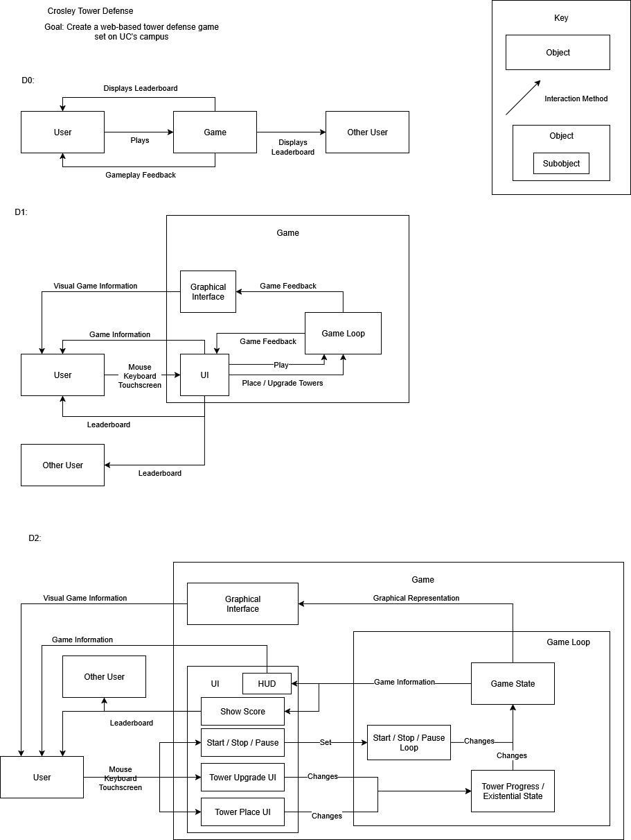

Slide 10
Project Constraints
Financial - Small budget -> Using Unity with free license
Legal - Project uses UC imagery -> No profiting off the work, and respectful as possible
Cultural - Featuring student characters from UC -> Making sure they represent an accurate slice of the student body

Slide 11
Project Progress
Finished Unity Pathways tutorial
Working on 2D Tower Defense fundamentals

Slide 12
Expected Accomplishments
Design defense placement and upgrade UI

Slide 13
Division of Work
Logan Castonguay - Programming, Game Design, UI Design
Art may be contracted

Slide 14
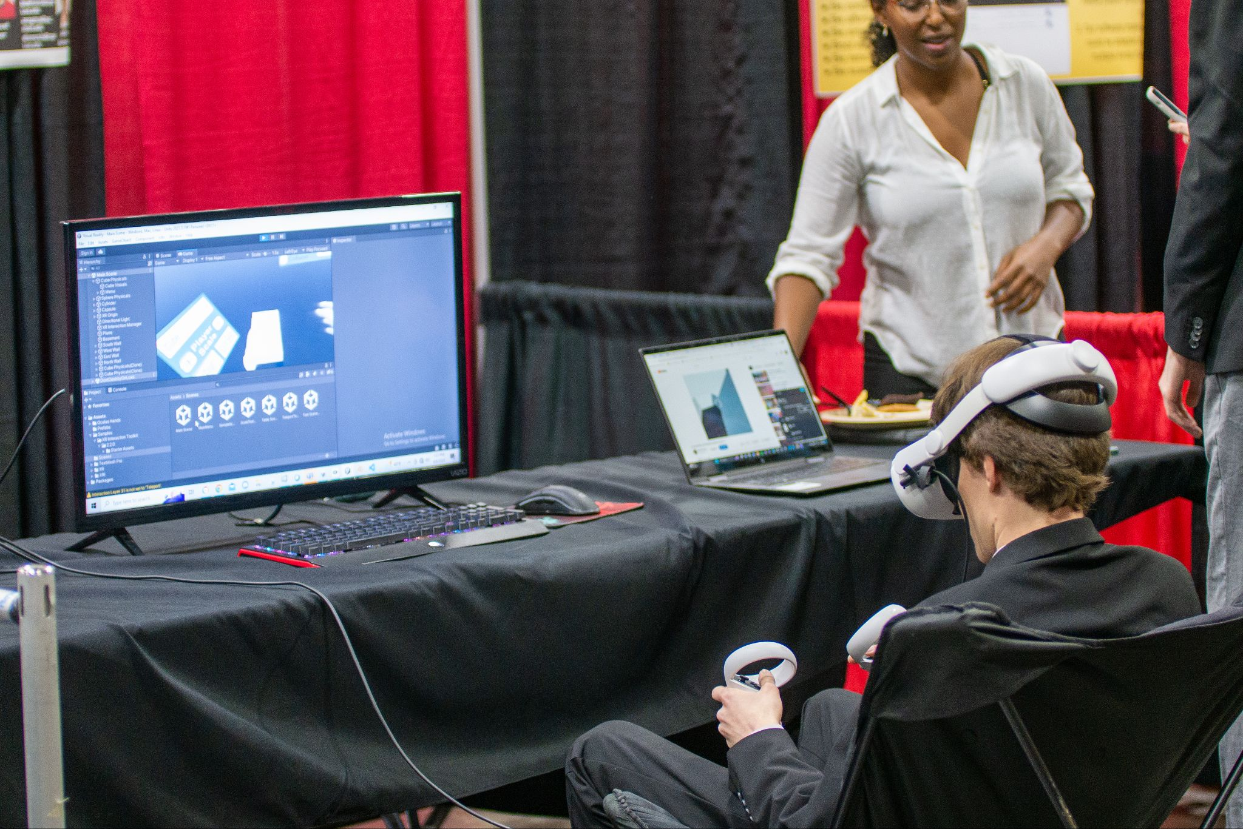
Expected Demo
Fully playable game with some waves designed
Functional live demo of the game on a PC that people can play

